Slide 1

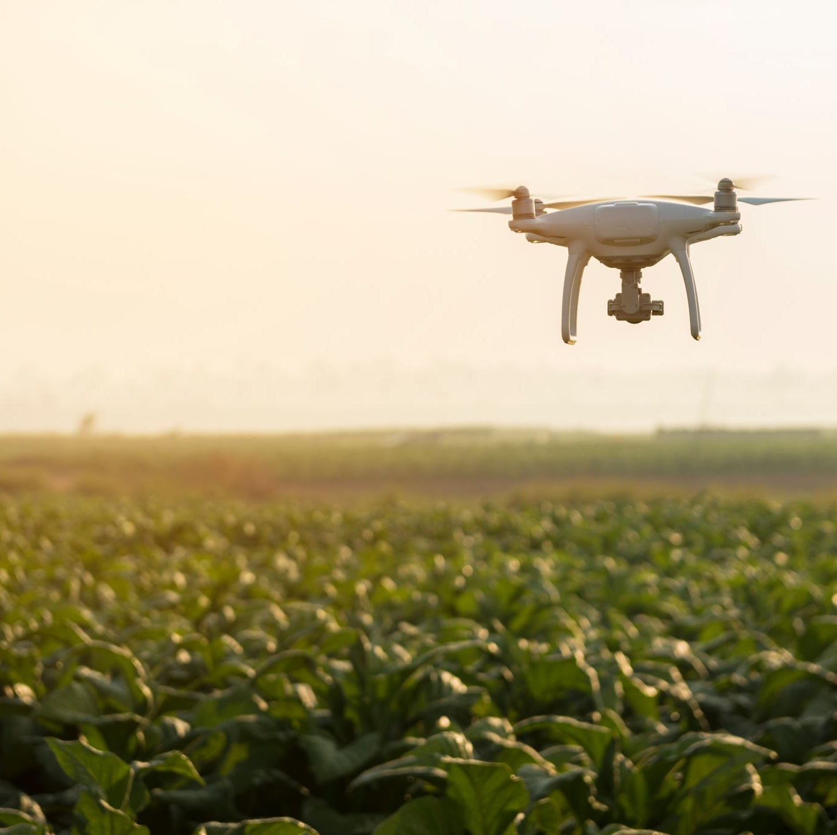
Modernizing Indian Agri Supply Chain Empowering Farmers through an Online Platform
Internship from
S4H TECHNOLOGIES,
VIJAYAWADA
Project In-charge:
S. Ravi Kumar, SAP COE
S4H Technologies
North America
Team members:
SRIHARI MADDINENI, Y20AIT507
BHARGAV KOMMINENI, Y20AIT453
POTTURI SRIRAM, Y20AIT490
THUMATI GOPI, Y20AIT511
Project Guide
Dr. B. Krishnaiah, Asst. Professor

Slide 2

Contents
Abstract
Literature survey
Existing system
Proposed system
System Design
Software and Hardware requirements
Conclusion

Slide 3

Abstract
Our project entails the design and development of an online web portal aimed at modernizing the Indian agricultural supply chain. Through this platform, farmers can list their products, engage in direct communication with buyers, and negotiate prices effectively. Buyers, in turn, gain access to a wide range of agricultural products, with the ability to filter and propose offers seamlessly. Leveraging technologies like React, Node.js, MongoDB, and Express.js, the portal ensures a user-friendly experience and secure transactions. Planning to host on AWS servers, to prioritize scalability and reliability. Ultimately, our project aims to empower farmers and streamline the agricultural trade process for a sustainable future.

Slide 4
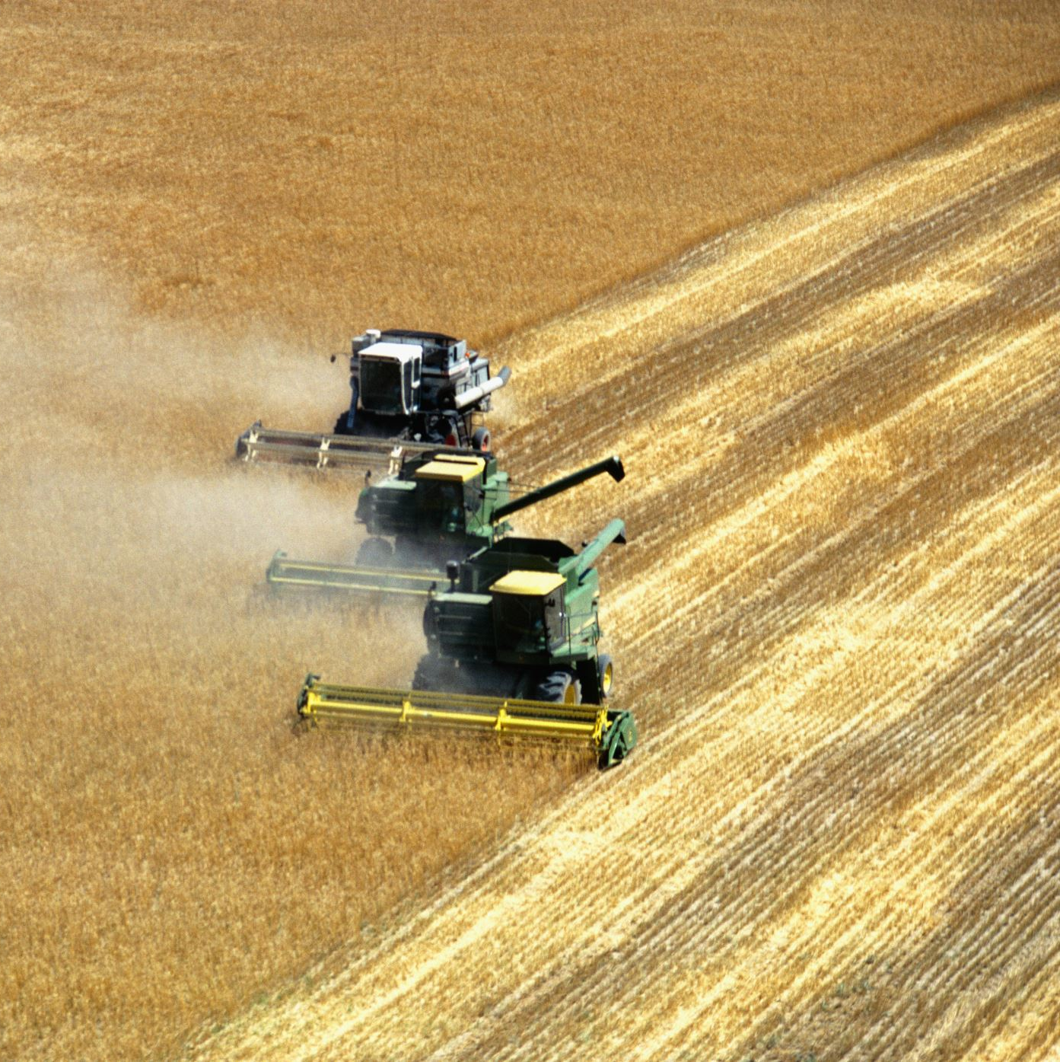
Literature survey
A study on the digitization of supply chains in agriculture - an Indian experience
Current state of farmers & commodities…
1.Farmers produce farm goods/commodities
2.Sometimes, farmers neither meet the price expected nor had
an opportunity to sell with price they wanted
3.In the mean while, products may get spoiled
4.Ex: tomatoes has as long as 5 days.
5.What should farmers do?

Slide 5

Literature survey
Context of selling procedure
Suppose farmer A has 100kg of tomatoes
These should be purchased by some middlemen
Middlemen offers some price and if negotiation fails, very few options for farmers to sell them
If found too…may be difficult to sell 100kg within 5 days
How could a farmer sell this with expected price, least product spoilage, with higher benefits?

Slide 6
Literature survey
Farmer should be able to
find buyers of that product in advance
They should be able to negotiate price they wanted
They should have to maintain contacts with buyers for the same

Slide 7
Existing system
E-NAM stands for Electronic National Agriculture Market. It's an online trading platform initiated by the Government of India to create a unified national market for agricultural commodities. E-NAM aims to connect existing agricultural produce market committees (APMCs) or mandis electronically, allowing farmers to sell their produce online to buyers across different regions and states. This platform enables transparent price discovery, reduces intermediaries, and provides farmers with better access to markets and buyers. E-NAM plays a crucial role in modernizing India's agricultural marketing system and empowering farmers by improving market access and ensuring fairer prices for their produce.
Importance of modernizing agri supply chain
Buyers (may be companies, farmers, others) and sellers will be able to communicate and negotiate price for the product.
Without sufficient money, equipment and with lot difficulties.

Slide 8
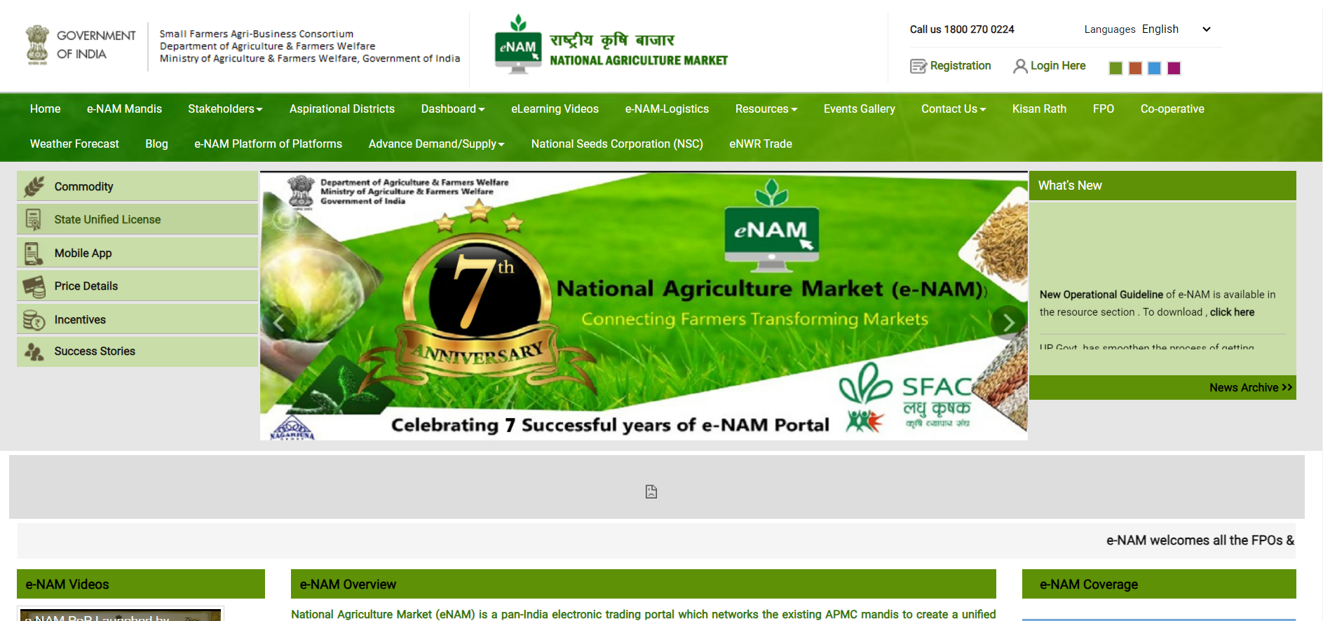
Existing system
Url : https://www.enam.gov.in/web

Slide 9
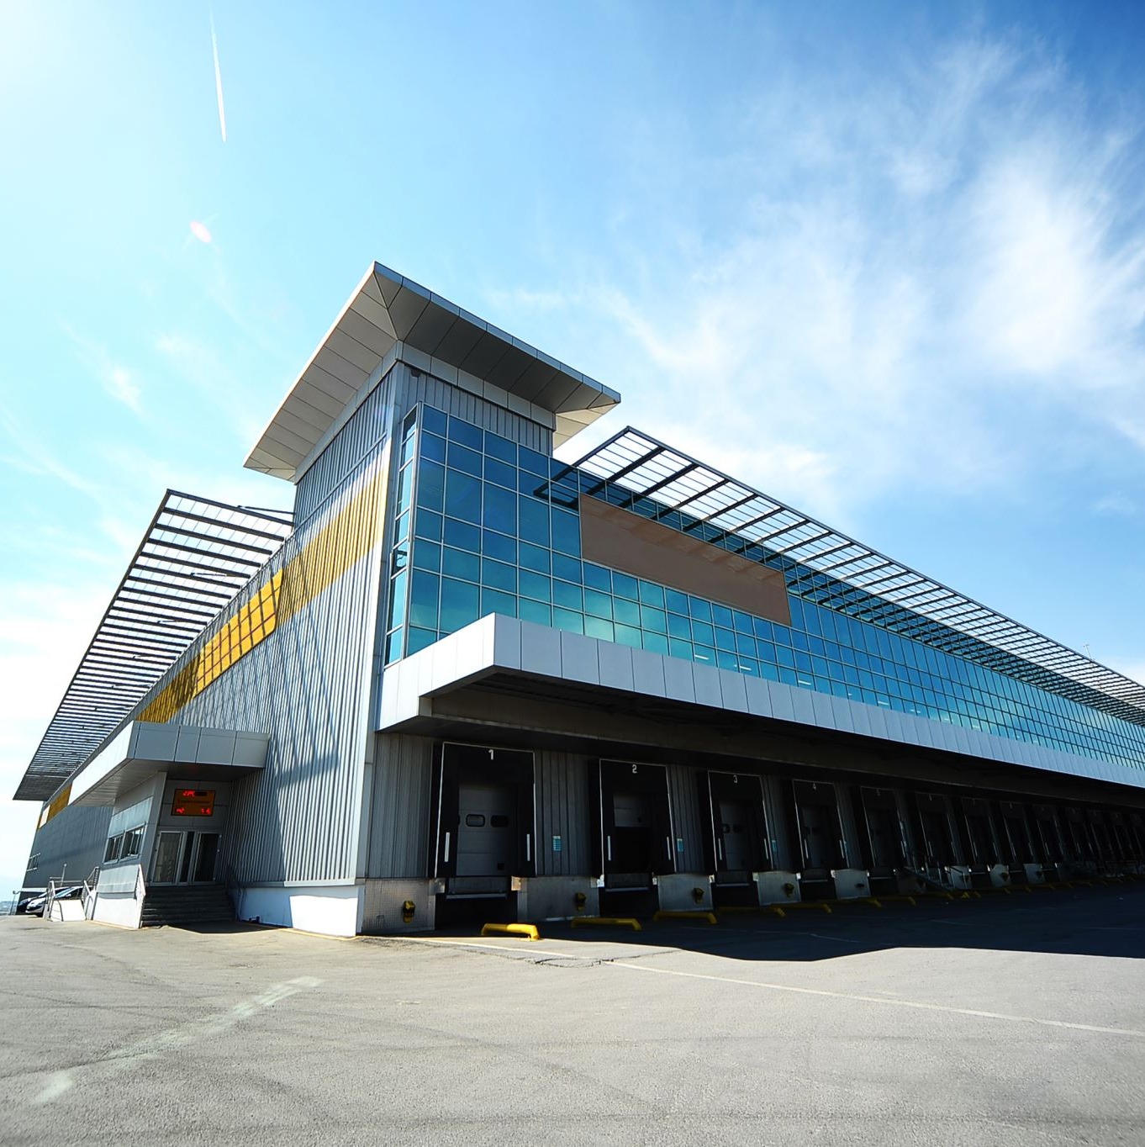
Proposed System
A platform named KisanRaj for farmers, as buyers, sellers, agents
Direct communication between buyer and seller
Buyer may be a farmer, even a company
Ex: ITC wants 1 ton of tobacco, it can communicate with farmers in this portal
Quality assurance is given
Location based services
MultiLanguage

Slide 10

Proposed System
Seller role (Farmer)
Seller has option to upload product, images, price, expected date of crop out product, shipping details, quantity, quality
Seller can update the product at any time
List the products
Delete the products
Look up for responses from buyers
Negotiate with them
Make a deal
Buyer role ( farmer, companies, ex: itc )
Company needs products in huge quantities
Quality assurance should be there
Can search for products that meets requirements
With high quality
With reasonable and negotiable price
Direct communication in case of any product not meeting deal proforma
Verified sellers (farmers)

Slide 11

Proposed System
Communication tools
Phone call
Whatsapp
Through website

Slide 12
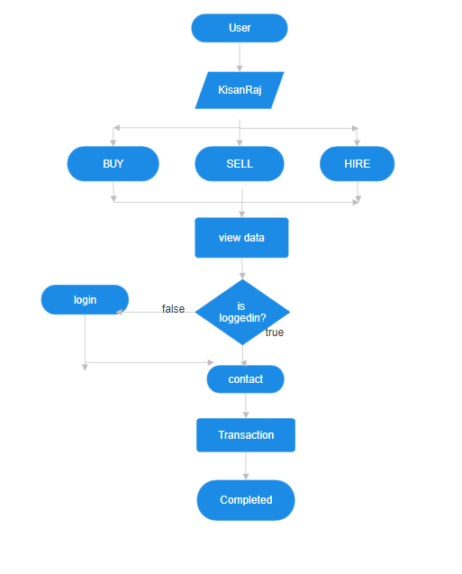
System Design
Architectural concepts
Front-end: React is a JavaScript library for building user interfaces.
Back-end: Node.js is a JavaScript runtime used for building server-side applications, while Express.js is a web application framework for Node.js, simplifying the process of building APIs and web applications.
Database: MongoDB is a NoSQL database program, which stores data in a flexible, JSON-like format, making it suitable for handling large volumes of structured, semi-structured, and unstructured data.
This stack is often used for its flexibility, scalability, and the ability to build real-time applications with JavaScript across the entire stack.

Slide 13

Software and Hardware Requirements
Software and Hardware Requirements
Software:
React for front-end development
Node.js and Express.js for server-side development
MongoDB for database management
AWS for hosting and deployment
Hardware:
A multi-core processor, at least 4GB of RAM, SSD storage, and compatibility with Linux-based operating systems.
Client-side hardware requirements: Any device with a modern web browser

Slide 14

conclusion
Our project aims to modernize the Indian agricultural supply chain through an online platform, promising to revolutionize farmer-buyer interactions. Leveraging advanced technologies and integrating features like direct communication, secure transactions, and E-NAM, we empower farmers, enhance market access, and ensure transparency and efficiency. With a focus on sustainability and scalability, our initiative signifies a crucial stride towards a more inclusive, resilient, and prosperous agricultural ecosystem in India.

Slide 15

Thanking You

